Slide 2
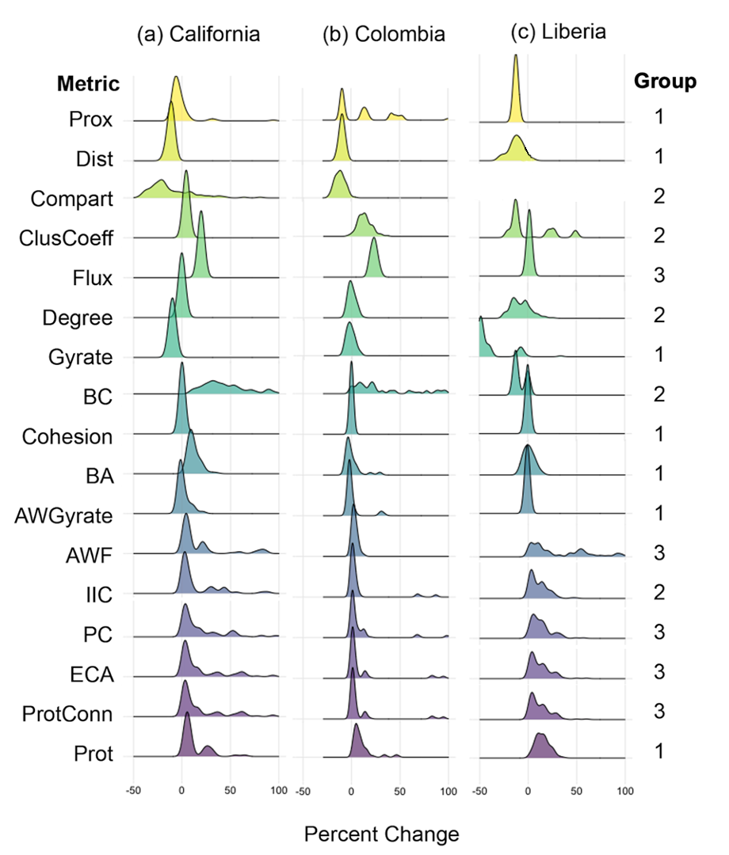

Slide 3
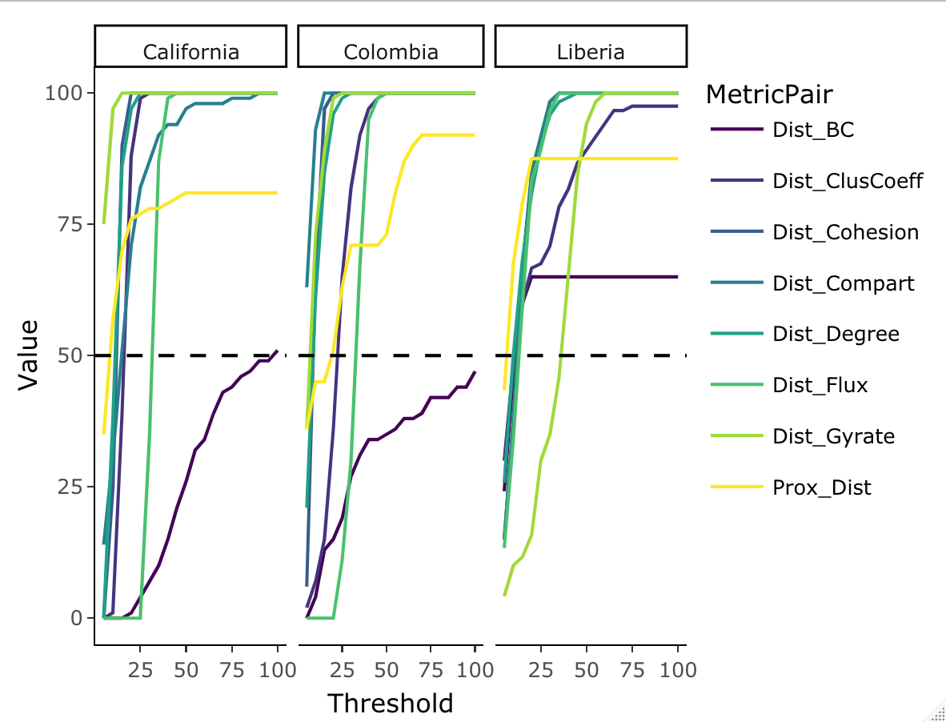
(a) California
(b) Colombia
(c) Liberia
Metric
BC
ClusCoeff
Cohesion
Compart
Degree
Proportion of simulations (%)
Flux
Gyrate
Prox
Absolute difference in percent changes with Dist

Slide 4
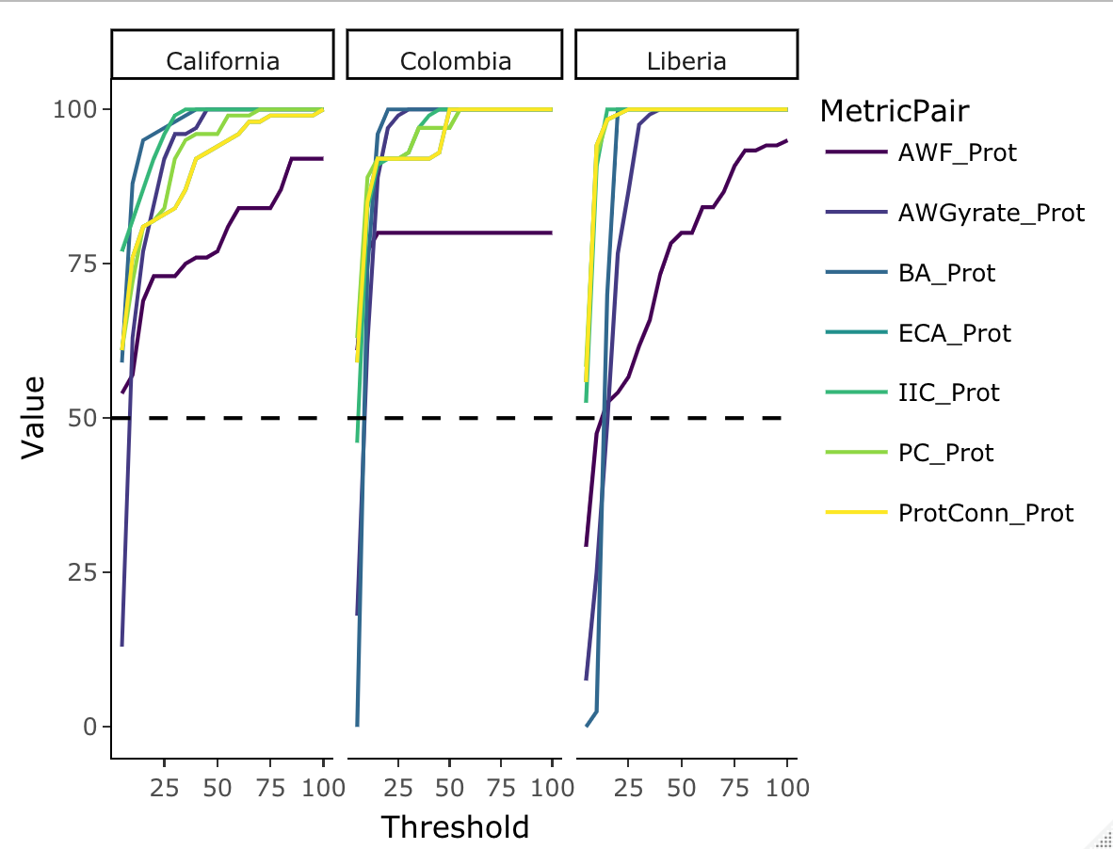
(a) California
(b) Colombia
(c) Liberia
Metric
AWF
AWGyrate
BA
ECA
IIC
Proportion of simulations (%)
PC
ProtConn
Absolute difference in percent changes with Prot

